Slide 1
Brendan Hartlove | The College Search Process
admissions.umd.edu | ApplyMaryland@umd.edu | 301.314.TERP (8377)

Slide 2
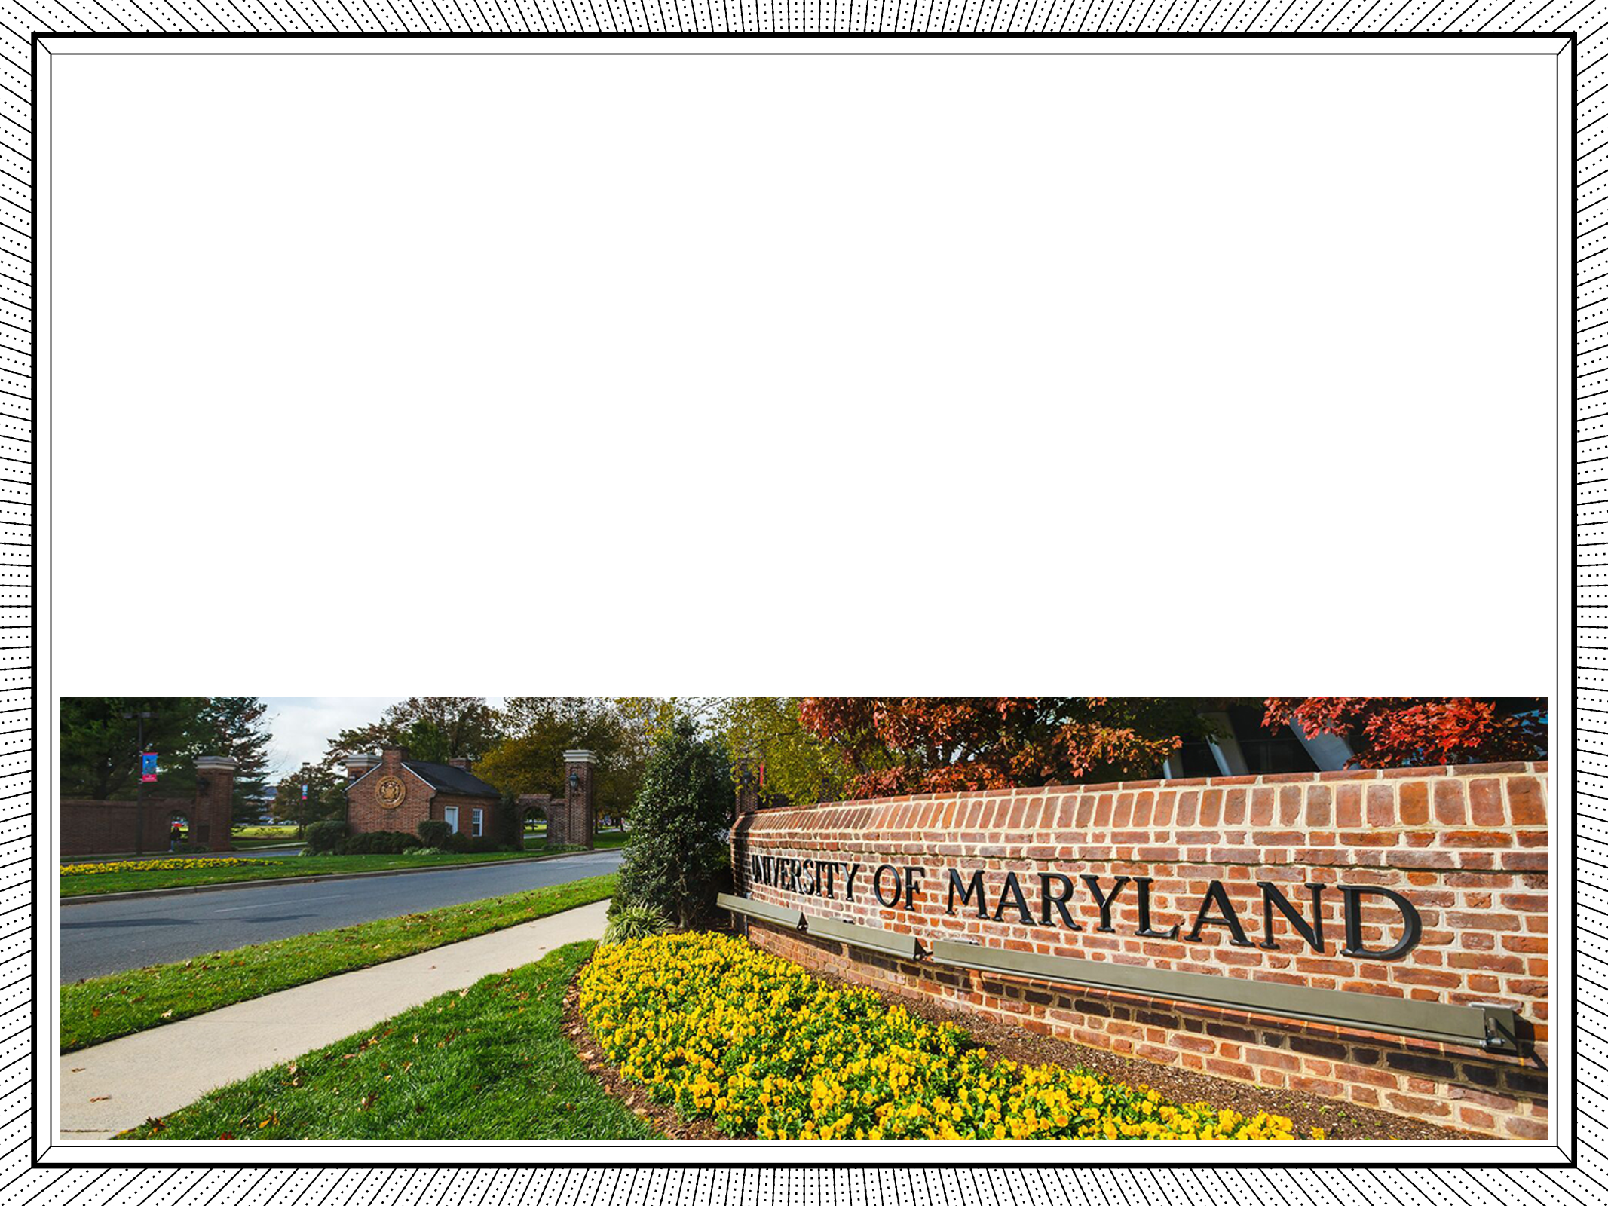
PRESENTATION OVERVIEW
The College Timeline: How to Prepare During High School
Exploring Best Fit
Campus Experiences

Slide 3
JUNIOR YEAR
Final preparations: continue academic excellence & extracurriculars
Stay involved and add leadership roles if you haven’t already
Maintain challenging course load and good grades
Select challenging courses for senior year
Resume building over the summer
Prepare for standardized tests

Slide 4
JUNIOR YEAR
Final preparations – the college search
Attend college search related events
Begin researching colleges
Identify key factors
Review college websites
Talk with your family
Begin visiting colleges and taking tours
Start a master calendar

Slide 5
SENIOR YEAR
Taking action
Fall Semester
Review your plan with your guidance counselor
Confirm admission and financial aid deadlines
Request letters of recommendation
Research merit scholarships
Spring Semester
Check status of applications
Apply for financial aid
Monitor your email for important updates
Keep up the hard work
Select your school of choice by May 1

Slide 6
EXPLORING BEST FIT
Consider the following things when researching and selecting colleges
Location / Academic Programs / Career building opportunities / Research and internship / Size of the school / Extracurricular involvement

Slide 7
CAMPUS EXPERIENCES
Campus tours
Campus events
Connect with staff and students
Inquire about interviews
Follow college social media accounts

Slide 8
Brendan Hartlove
admissions.umd.edu | ApplyMaryland@umd.edu | 301.314.TERP (8377)

