Slide 1
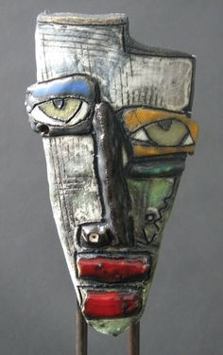
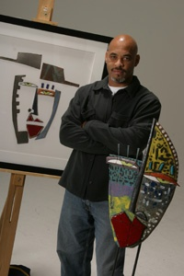
Kimmy Cantrell
“Little Coal Miner”

Slide 2
Some facts about Kimmy Cantrell…
He mostly makes ceramic faces, still lifes and figures.
He lives in College Park, Georgia.
He is mostly self-taught.
He was liked ceramics class in high school.
He studied business in college and worked in business management (not art) for 12 years.
Once he decided to get back to doing his art, he quit his office job and made art full time.
He has his art in many galleries and art shows and has won awards for art work.

Slide 3
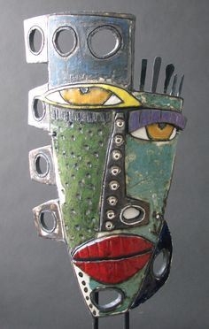
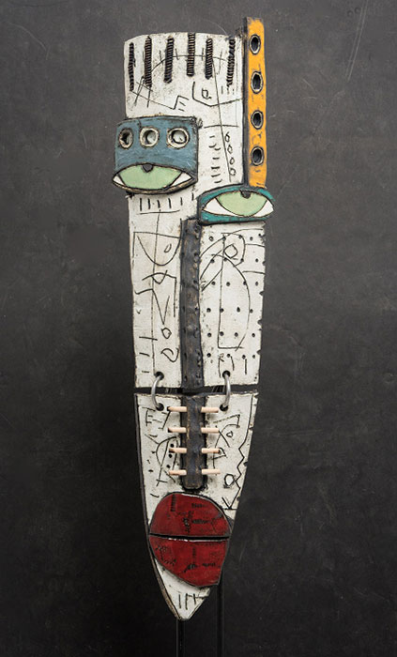
“There are stories behind every line, wrinkle and scar on a human body. I hope to show the beauty within those flaws.” Kimmy Cantrell
“Primitive Etiquette”
“My Tribe”

Slide 4
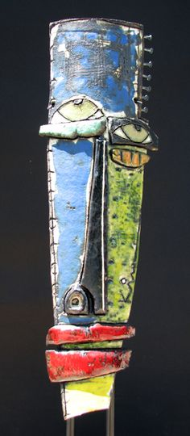
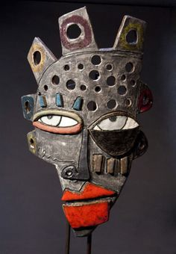
“Imperfections tell stories that are far more compelling than perfection.”
“Cirque Mask”
“Homeless”

Slide 5
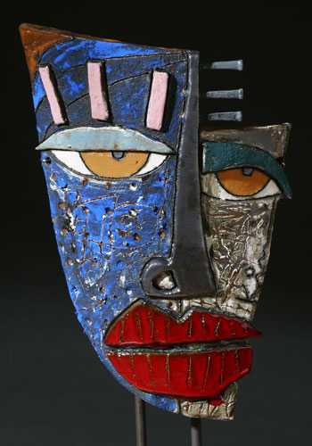
“I always loved primitive art, and I try to reflect that raw, primitive style in my own interpretations. Some of my work is tribal, and some is more universal. We all have roots, and the roots tend to come out in the works we create.”
“I manipulate the shape and position of eyes to express a range of emotions,” he remarked,
“and the titles of my work often reflect my own life experiences.
“Tough Times”

Slide 6
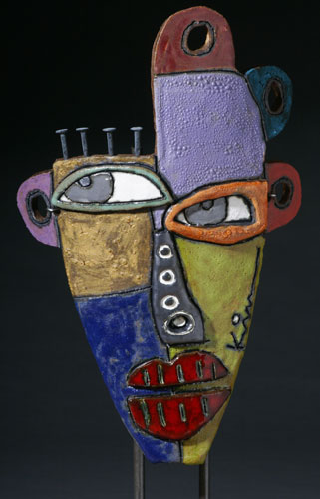
Me, Myself and I

Slide 7
Directions for our project: (Day 1-2)
Sketch 2 ideas in your sketchbook of a self portrait.
Show geometric shapes.
Use abstract designs.
Show a feeling or emotion.
Cut your best design out of cardboard and glue all the pieces on securely.
Be sure to layer some of the pieces.

Slide 8
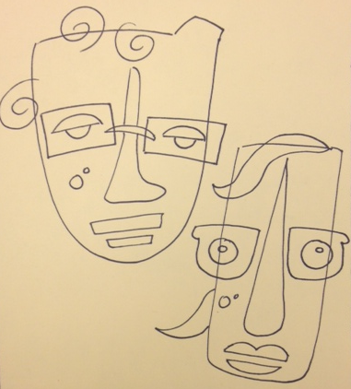
2 sketches that show abstracted, simple shapes and focus on features of the artist that are unique.
SKETCHBOOK

Slide 9
Cardboard (cereal box) printing plate completed.

Slide 10
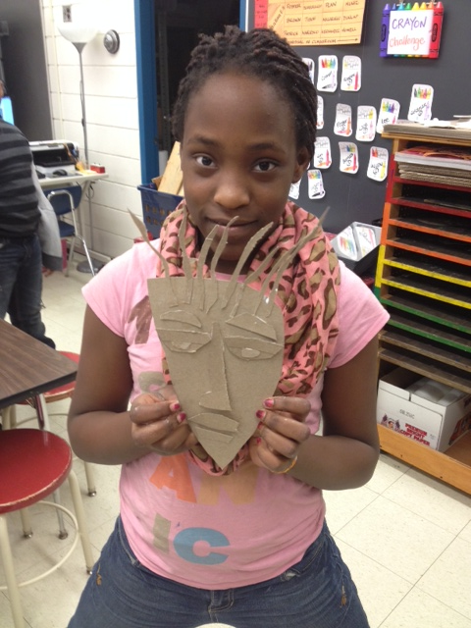

Slide 11
Printing: Crayon Rubbing
Use the crayon rubbing technique and several colors to make a rubbing of your print.
Hold your paper very still with one hand while you rub.
Be sure to rub the entire face.

Slide 12
Crayon Rubbing

Slide 13
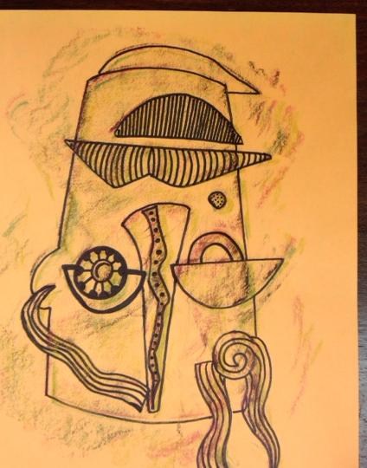
Do 2 crayon rubbings.
Use 2-3 colors on each one.
Elaborate the crayon rubbing by adding lines and patterns with a black sharpie.
Show Ms. Boyer your project before you start to use the ink and roller.

Slide 14
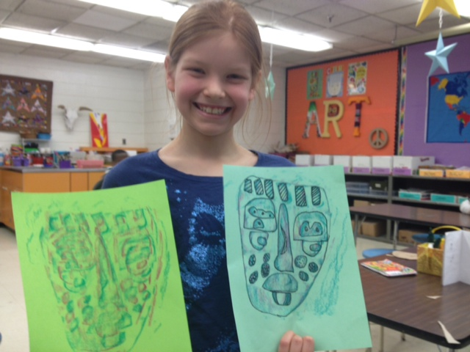

Slide 15
Printing:
Ink and brayer
Use ink and a brayer to print your self portrait.
Print it 2 times on solid color paper.
Print 1 time (in black only) on print paper.
Write your name very small on the bottom of your paper.
Put all your prints into the drying rack.

Slide 16
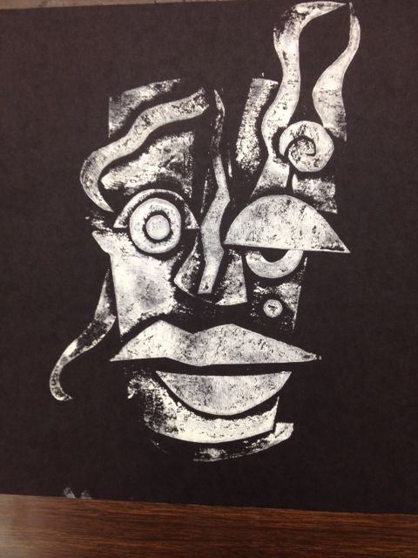
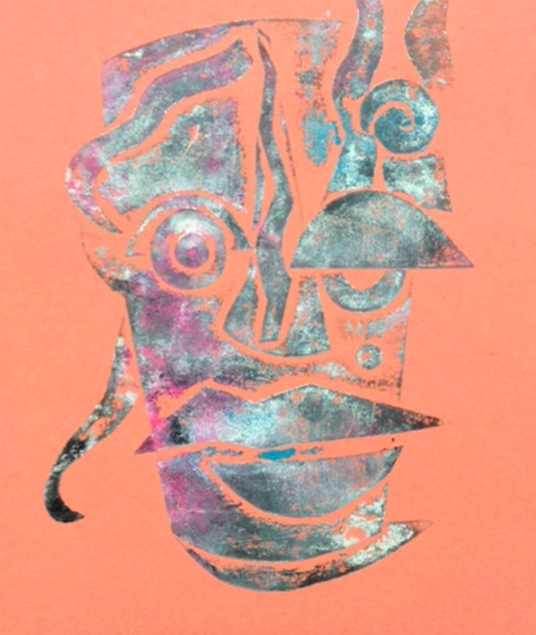
Color prints on paper

Slide 17
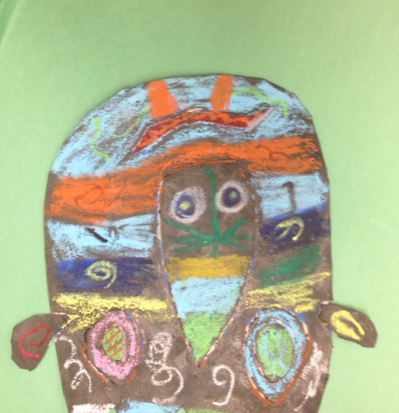
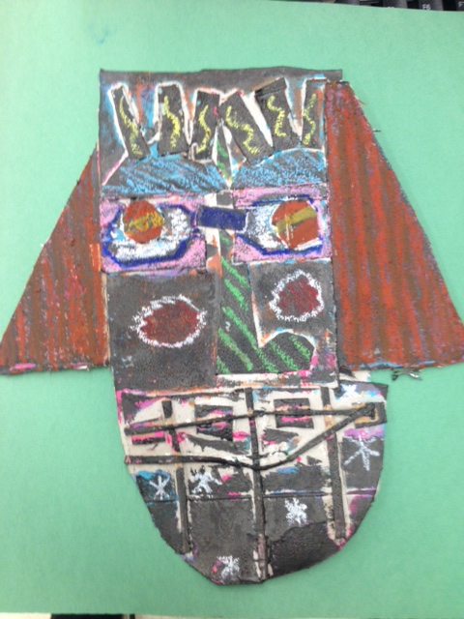
Use oil pastels to create patterns and designs on your (now) black printing plate.

Slide 18
Notes:
For next year:
Curriculum
Show the kids how to cut and layer the faces. They try to draw the features rather than cut them out.
Check the size of the outside of the face before adding the details. Sometimes they are too small or too big.
Concepts/topics:
Communication of ideas: texture (visual and tactile) movement (direction of the viewer’s eye) aesthetic qualities.
Enduring understanding: observation, memory, feelings and imagination inspire artwork that communicates personal connections, values, beliefs, meanings and ideas.
Essential question: how do artists communicate ideas?

