Slide 1
Financial Aid

Slide 2
Topics We Will Discuss
What is financial aid?
FAFSA & CSS Profile
Cost of attendance (COA)
Student aid index (SAI)
Financial need
Categories, types, and sources of financial aid
Free Application for Federal Student Aid (FAFSA®)
Special and unusual circumstances

Slide 3
What is Financial Aid?
Financial aid consists of funds provided to students and families to help pay for postsecondary educational expenses.

Slide 4
Sources of Financial Aid
Federal Government
Employers
States
Private Sources
College and Universities

Slide 5
How to Apply for Financial Assistance

Slide 6
FSA ID
An FSA ID gives you access to Federal Student Aid’s online systems and serve as your legal signature.
Both the student AND parents need to create one.
Will be used throughout the aid process, including subsequent years.
http://studentaid.gov/
*In most cases both parents need an FSA ID

Slide 7
FSA ID

Slide 8
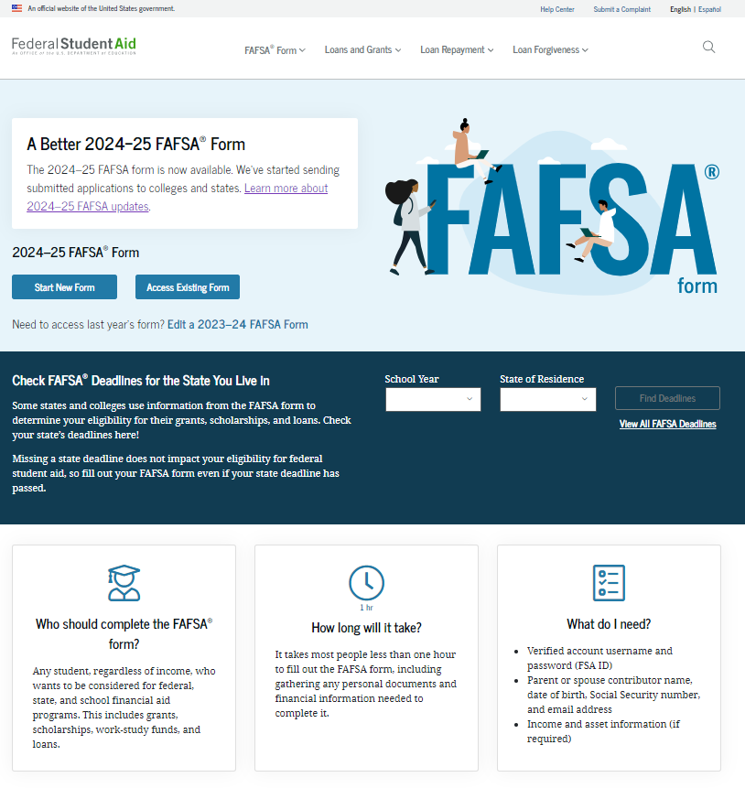
Online FAFSA

Slide 9
Free Application for Federal Student Aid (FAFSA)
Filed starting December 1* of the year prior to enrolling
Typically will open October 1
MUST be filled to receive federal aid
Required for some state and institutional as well
A standard federal form that collects demographic and financial information about student and family
May be filed at any time during an academic year, but no earlier than the October 1st prior to the academic year for which the student requests aid

Slide 10
Free Application for Federal Student Aid (FAFSA)
Student & parent complete separate workflows
No “single view” of the application
Multi-factor verification
Student
Parent
Begins application and invites the Parent

Slide 11
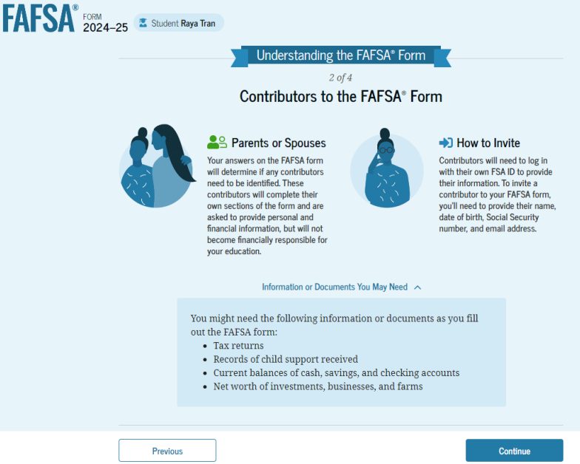
FAFSA Contributors
Note: Screenshot from U.S. Department of Education’s 2024-25 FAFSA Form Preview Presentation, July 2023

Slide 12
FAFSA Info
Generates the Student Aid Index (SAI)
Makes it easier for families to estimate aid eligibility
All income tax data will automatically be transferred form the IRS
All parties must authorize the transfer of information
Dependent students must invite their parent(s) to contribute to their form if parent information is required

Slide 13
FAFSA FAQs
Divorced/Separated Parents
The parent that supplied more financial support for the student will be the parent of record
You will not be able to make adjustments to the transferred data
Having more than one child in college will not be reflected in the SAI

Slide 14
CSS Profile
CollegeBoard Financial reporting
Used to determine institutional aid eligibility
Includes private assets in EFC calculation
Fee for initial application and one college report is $25.
Additional reports are $16.
Waiver for families AGI < $100k or SAT Waiver
Used by approx. 400 colleges and scholarship programs
Only 3 in MD
Notes:
Hopkins University
Loyola University
St. Johns College

Slide 15
How is all of this information used?

Slide 16
What is the Student Aid Index (SAI)?
Calculated by formula in FAFSA
Stays the same regardless of college
The SAI is an eligibility index number that a college’s financial aid office uses to determine how much aid a student is eligible for.

Slide 17
How is the SAI Determined?
SAI Calculation uses fewer income fields
Tax Info (AGI)
This will be automatically pulled from the IRS database.
Tax-exempt Interest
Untaxed portions of IRA distributions and pensions (excluding rollovers)
529 plans
Only for the student filing the FAFSA

Slide 18
How do schools use this data?

Slide 19
What is Cost of Attendance (COA)?
Direct costs
Tuition
Fees
Housing
Meals
Indirect costs
Books & Supplies
Transportation
Personal Expenses
Loan Fees
Cost of Attendance

Slide 20
What is Financial Need?
Cost of Attendance
Student Aid Index (SAI)
Financial Need

Slide 21
Categories of Aid
Need-based aid
Non-need-based aid

Slide 22
Types of Aid
Scholarships
Grants
Work-Study Employment
Loans
Self-Help Aid
Gift Aid

Slide 23
Main Sources of Aid

Slide 24
Institutional Funding
Scholarships
Awarded for student achievement regardless of financial need
Universities will have separate scholarship applications for the different colleges
Grants
Need based funds offered to assist in covering CoA

Slide 25
State Funding
An only be used for MD schools
Aid is awarded on the basis of both merit and need
FAFSA is required for some
Priority Deadline March 1, 2025.
For MD funding check Maryland Higher Education Commission (MHEC) www.mhec.state.md.us
Legislative Scholarships
www.mdelect.net

Slide 26
Federal Funding
Grants
TEACH
Future teachers, specific requirements
PELL
Low Income
SEOG
Low Income
Work-Study Programs
Work on off campus
Loan Programs

Slide 27
Outside Scholarships
Scholarship search engines
Fastweb
Scholarships.com
Cappex
Scholly
Niche
Scholarship Monkey
Scholarships are everywhere

Slide 28
Loan Types
Stafford Loans
Student Loans
Subsidized
Unsubsidized
PLUS Loans (Parent)
Private Source Loans
Banks
Credit Unions
Private Loan Servicer

Slide 29
Subsidized VS. Unsubsidized
Direct Subsidized Loans are available to undergraduate students with financial need.
Your school determines the amount you can borrow, and the amount may not exceed your financial need.
The U.S. Department of Education pays the interest on a Direct Subsidized Loan
while you’re in school at least half-time,
for the first six months after you leave school
during a period of deferment
Direct Unsubsidized Loans are available to undergraduate and graduate students.
Your school determines the amount you can borrow based on your cost of attendance.
You are responsible for paying the interest on a Direct Unsubsidized Loan during all periods.
If you choose not to pay the interest while you are in school and during grace periods, your interest will accrue and be capitalized

Slide 30
What else…

Slide 31
Special Circumstances
Conditions exist that cannot be documented with the FAFSA
Send written explanation and documentation to your college’s financial aid office
College will review and request additional information if necessary
Colleges are now required to accept appeals

Slide 32
Secondary school tuition
Unusual uncovered medical/dental expenses
Extraordinary dependent care
Parent or spouse death
Loss of employment
Divorce

Slide 33
Financial Aid Packages
Financial Aid Packages after admission notification
SMCM **
Early Decision
Mid December
Early Action Applicants
Mid December
Regular Decision
Early March
Will include (if eligible)
Federal Grants
State Grants
Institutional Need Based Grants
Institutional Scholarships
Federal Loan options

Slide 34
Tools You Can use
Federal Student Aid
https://studentaid.gov
Federal Student Aid Estimator
Help to get an idea of SAI/Need
“College Cost Worksheet”
Who counts as a parent on the FAFSA® form?
Pro Tips for Completing the FAFSA Form
Federal Student Aid YouTube Channel: FAFSA Videos
“Creating Your StudentAid.gov Account” Page

Slide 35
Tools You Can use
Sallie Mae FAFSA Guide
https://www.salliemae.com/college-planning/financial-aid/fafsa/fafsa-guide/
Net Price Calculators (NPC)
Every Title IV school is required to have one

Slide 37
Questions? Contact Info: www.smcm.edu/osfa osfa@smcm.edu

